Slide 1
Project Scheduling
CSE347 – System Analysis and Design
Instructor
Md Sabbir Hossain
CSE, EWU

Slide 2
A project is defined as a
set of interrelated activities that must be completed in a certain order
to attain a certain outcome

Slide 3
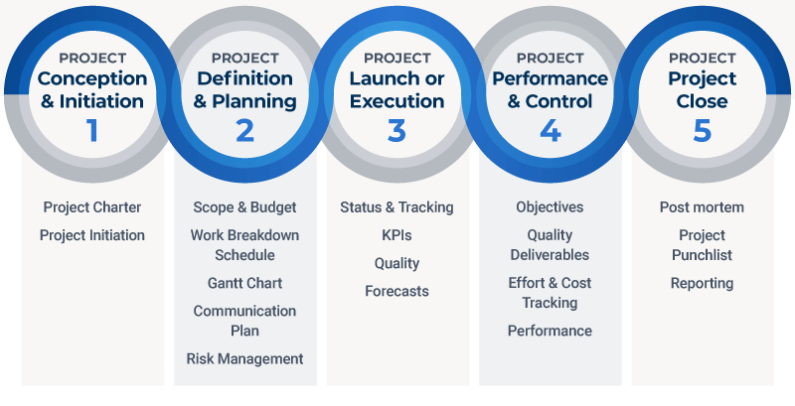
Project Management Phases

Slide 4
Major Phases
Planning
Divide the project into distinct activities
Estimate the requirement for activities
Establish precedence relationship
Construct arrow diagram
Controlling
Making the periodical progress report
Reviewing the progress
Analyzing the status of the project
Scheduling
Determine the start and end time for activity
Determine the critical path on which the activity require attention
Determine the slack and float for non-critical path

Slide 5
Project scheduling
Scheduling is a part of project management that involves
listing activities,
milestones, and
deliverables within a project.
The schedule also includes start and end dates, the length of the project, and the resource management needed to complete each activity.

Slide 6
Project scheduling
A well-developed project schedule ensures the project is completed on time and produces the desired quality of outcomes.
It outlines all your task deadlines at different project stages, and you can later use it to measure project progress step by step.
A good schedule helps you break a project into major milestones, which lets you assess how successful you are in following the plan and see whether you are on the right track and getting closer to your goals.
The designed timelines also hold everyone accountable for their performance, including the quality of outputs and work delays.

Slide 7
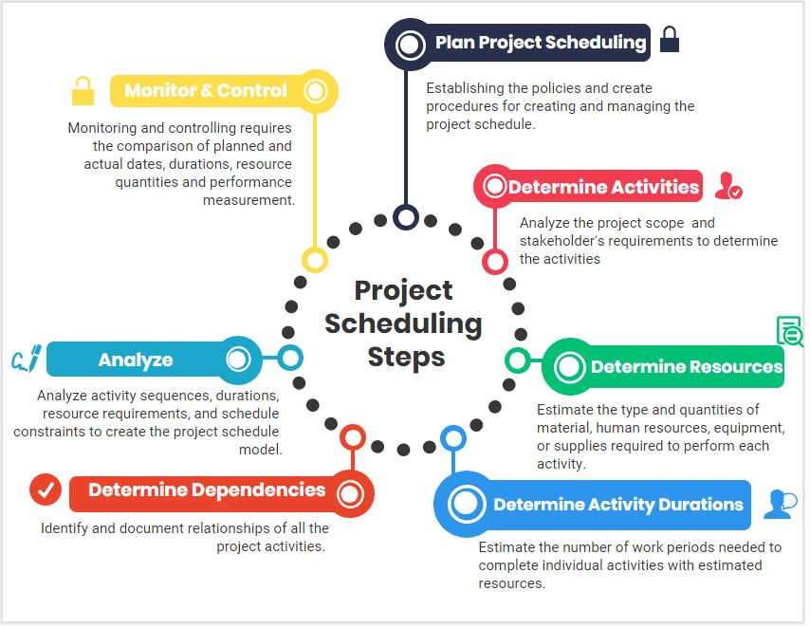
Steps of project scheduling

Slide 8
Project Scheduling Techniques
Mathematical analysis:
Using mathematical logic, calculate project timeline with all the factors of the project scope considered.
Critical Path Method (CPM)
Project Evaluation and Review Technique (PERT)
Duration compression
Applying duration compression, to adjust scheduling without impacting the whole project’s timeline. Cut scheduling shorter if a project is falling behind.
Fast Tracking
Crashing
Simulation
If the project involves many uncertain variables and unclear final results, the simulation could help schedule project management.
Resource-leveling heuristics
Cutting the delivery time or avoiding under or overutilization of resources by making adjustments with the schedule or resources is called resource leveling heuristics.
Gantt charts
Gantt chart will help to visualize the overall scheduling of your project
Task lists
The task list is the simplest project scheduling technique of all the techniques available.
Calendar

Slide 9
Critical Path Method

Slide 10


The critical path method (CPM) is a technique that allows to identify tasks that are necessary for project completion and determine scheduling flexibilities.
A critical path in project management is the longest sequence of activities that must be finished on time to complete the entire project. Any delays in critical tasks will delay the rest of the project.

Slide 11
Origin
The CPM was developed in 1950s by Morgan R. Walker of Duport (Chemical Company) and James E. Kelley Jr. of Remington Rand (Mechanical Manufacturer)
It was first used in missile-defense construction project
Since that time, CPM has been adopted to other fields including hardware and Software product research and development

Slide 12
Where is it used?
Software Development
Construction
Projects
Aerospace & Defense
Research Projects
Product Development
And many more…

Slide 13
Why CPM?
Some reasons why you should use this method:
Improves future planning: CPM can be used to compare expectations with actual progress. The data used from current projects can inform future project plans.
Facilitates more effective resource management: CPM helps project managers prioritize tasks, giving them a better idea of how and where to deploy resources.
Helps avoid bottlenecks: Bottlenecks in projects can result in lost valuable time. Plotting out project dependencies using a network diagram, will give you a better idea of which activities can and can’t run in parallel, allowing you to schedule accordingly.

Slide 14
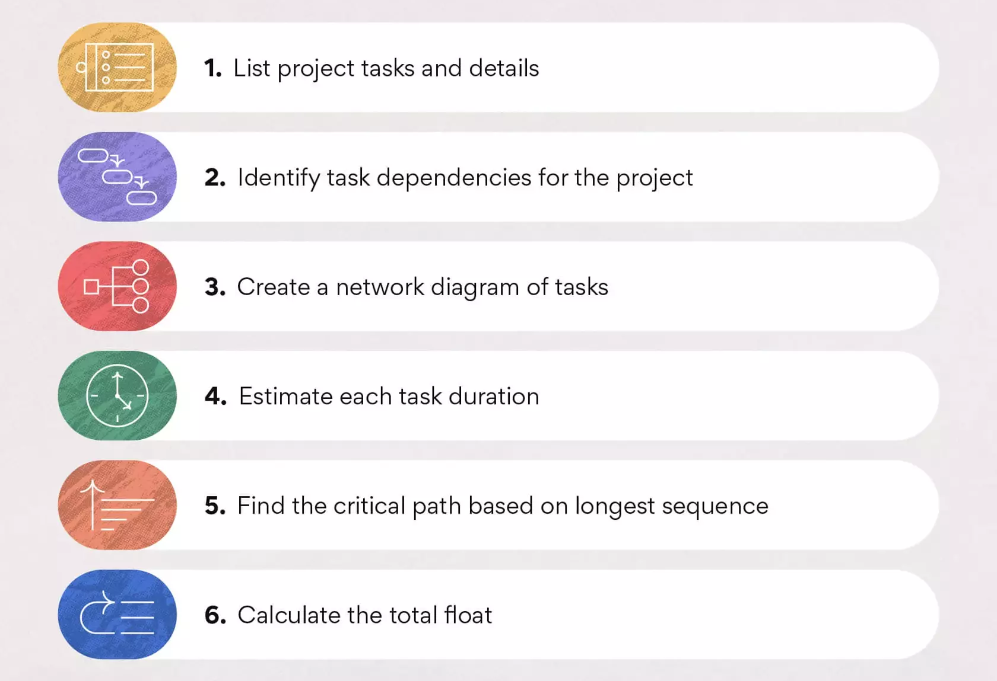
Finding Critical Path

Slide 15
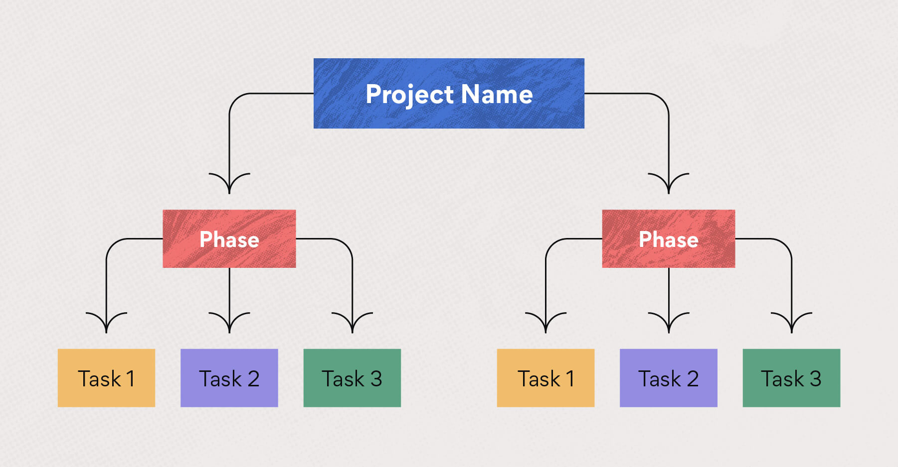
How to find the critical path
List activities: Use a work breakdown structure (WBS) to list all the project activities or tasks required to produce the deliverables.

Slide 16
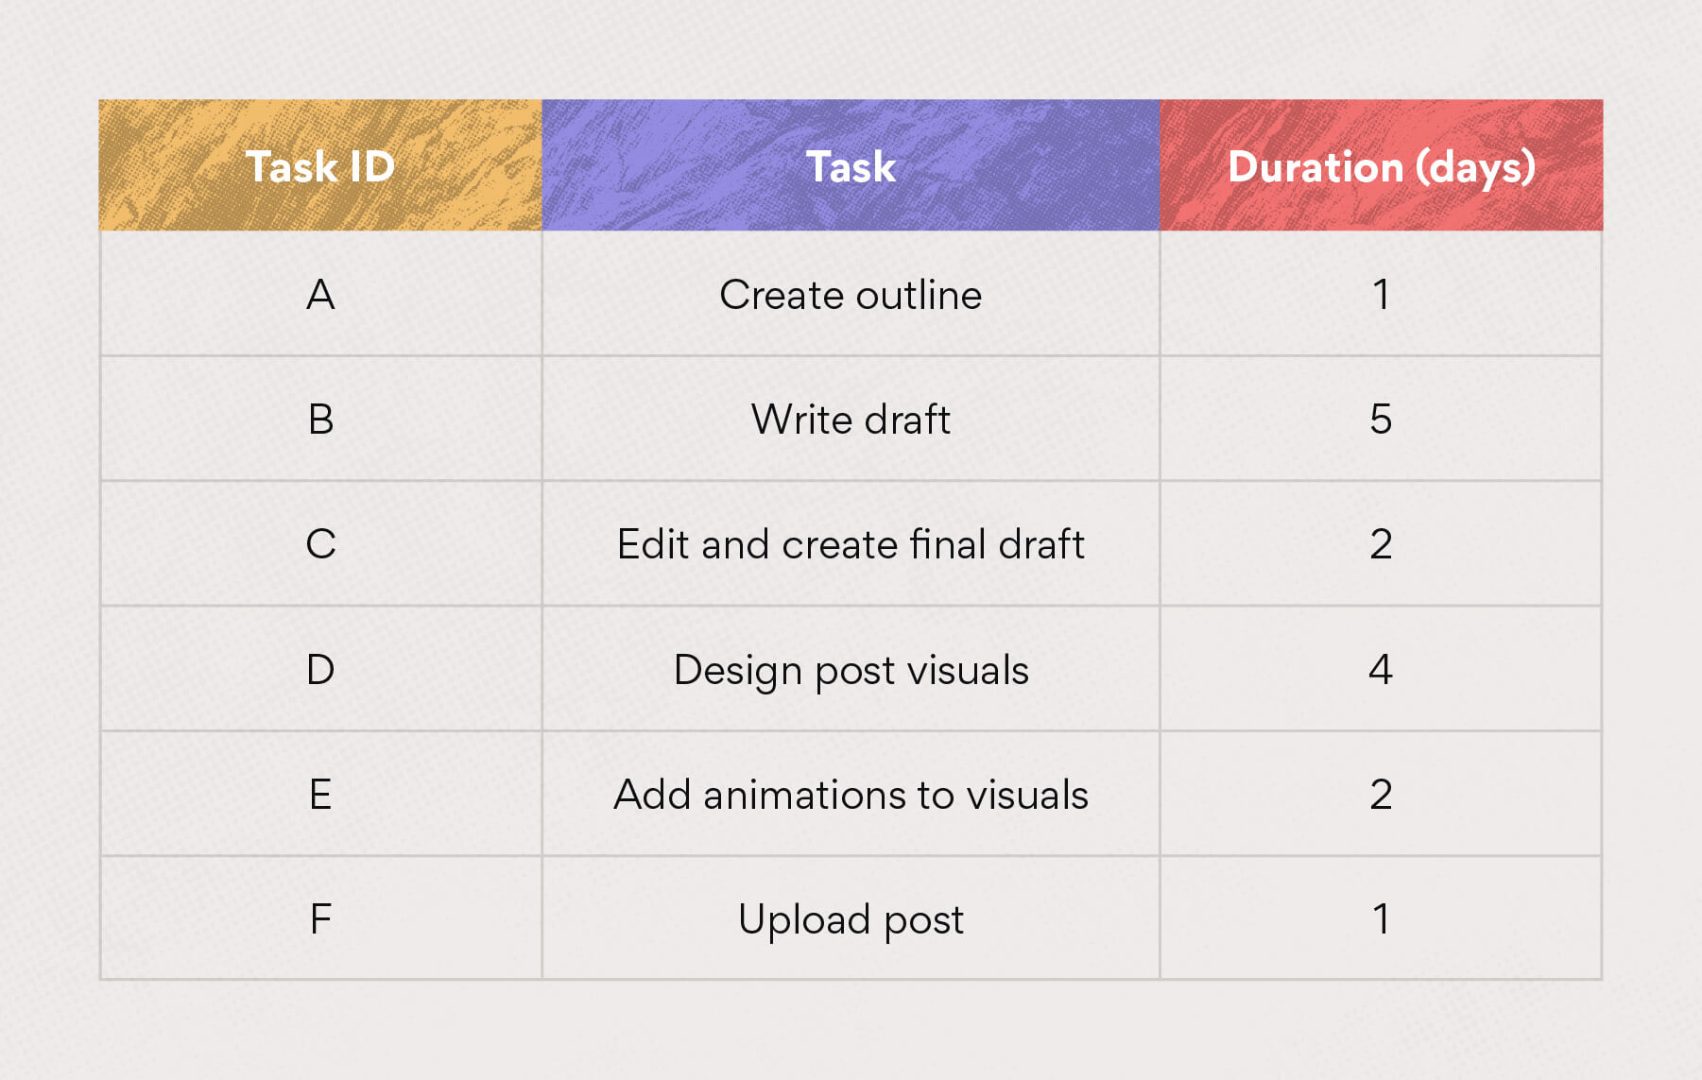
For example, let’s say the marketing team is producing a new interactive blog post. Here are some tasks that might be in the work breakdown structure:

Slide 17
Steps in Critical Path Method…
2. Identify dependencies: Based on your work breakdown structure, determine the tasks that are dependent on one another.
Task B is dependent on A
Task C is dependent on B
Tasks C and D can run in parallel
Task E is dependent on D
Task F is dependent on C, D, and E

Slide 18
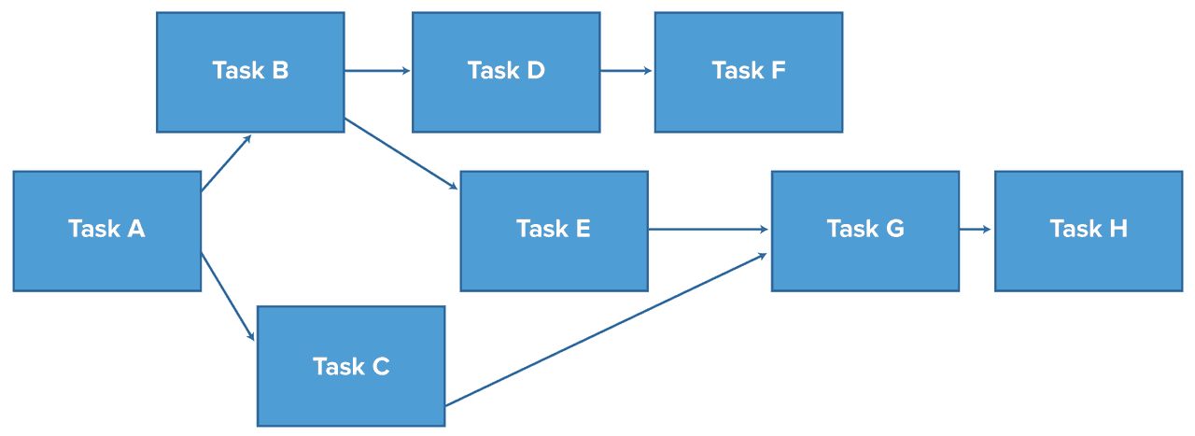
Steps in Critical Path Method…
3. Create a Network Diagram: Turn the work breakdown structure into a network diagram, which is a flowchart displaying the chronology of activities. Create a box for each task and use arrows to depict task dependencies.

Slide 19
Steps in Critical Path Method…
4. Estimate each task duration
Making educated guesses based on experience and knowledge
Estimating based on previous project data
Estimating based on industry standards

Slide 20
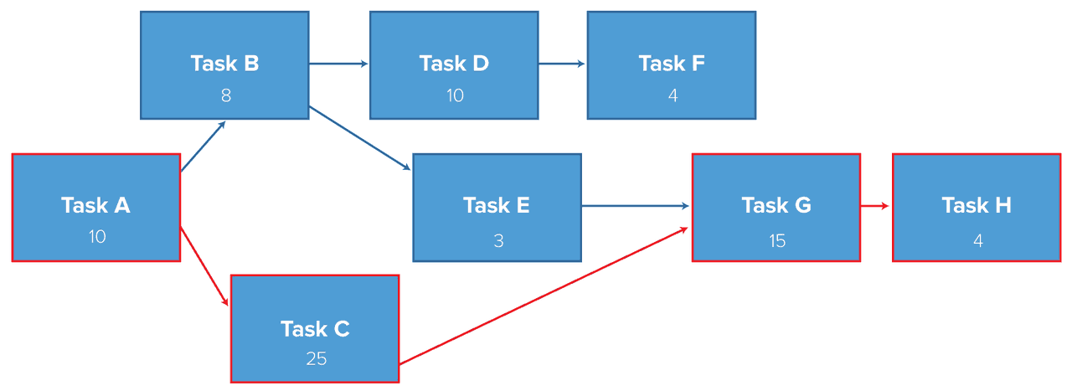
Steps in Critical Path Method…
5. Calculate the critical path
There are two ways to identify critical path
Check the network diagram and identify the longest path in the network
Identify
critical activities with Forward/Backward Pass technique
Earliest start and finish, latest start and finish of each activity

Slide 21
Steps in Critical Path Method…
Calculating the critical path can be done manually, but you can save time by using a critical path algorithm instead.
The steps to calculate the critical path manually:
Step 1: Write down the start and end time next to each activity.
The first activity has a start time of 0, and the end time is the duration of the activity.
The next activity’s start time is the end time of the previous activity, and the end time is the start time plus the duration.
Do this for all the activities.
Step 2: Look at the end time of the last activity in the sequence to determine the duration of the entire sequence.
Step 3: The sequence of activities with the longest duration is the critical path.

Slide 22
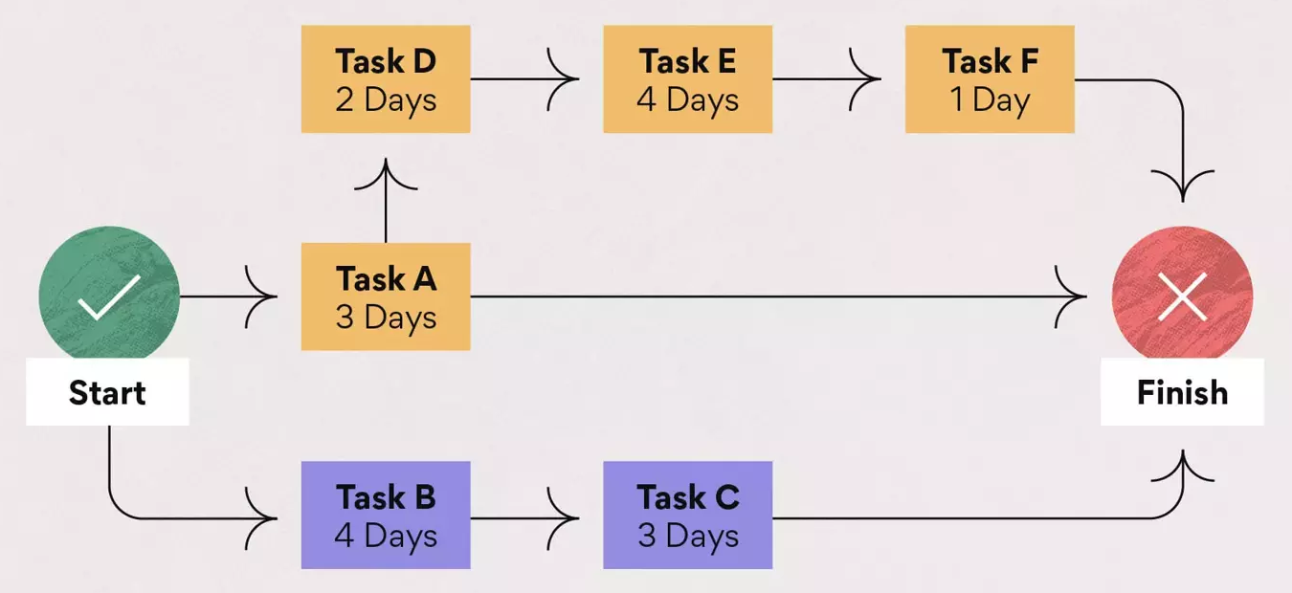
Steps in Critical Path Method…

Slide 23
Steps in Critical Path Method…
6. Calculate the float
Float, or slack, refers to the amount of flexibility of a given task. It indicates how much the task can be delayed without impacting subsequent tasks or the project end date.
Finding the float is useful in gauging how much flexibility the project has. Float is a resource that should be used to cover project risks or unexpected issues that come up.
Critical tasks have zero float, which means their dates are set. Tasks with positive float numbers belong in the non-critical path, meaning they may be delayed without affecting the project completion date. If you’re short on time or resources, non-critical tasks may be skipped.

Slide 24
Project managers benefit from having a good understanding of float:
It keeps projects running on time: Monitoring a project’s total float allows you to determine whether a project is on track. The bigger the float, the more likely you’ll be able to finish early or on time.
It allows you to prioritize: By identifying activities with free float, you’ll have a better idea of which tasks should be prioritized and which ones have more flexibility to be postponed.
It’s a useful resource: Float is extra time that can be used to cover project risks or unexpected issues that come up. Knowing how much float you have allows you to choose the most effective way to use it.

Slide 25
Activity — A task or set of tasks required by the project. Activities use resources and time.
Event — An identifiable state resulting from the completion of one or more activities. Events consume no resources or time. Before an event can be achieved or realized , all its predecessor activities must be completed.
Network — A diagram of nodes (may represent activities or events) connected by directional arcs (may represent activities or simply show technological dependence) that defines the project and illustrates the technological relationships of all activities. Networks are usually drawn with a “ Start ” node on the left and a “ Finish ” node on the right. Arcs are always tipped with an arrowhead to show the direction of precedence, that is, from predecessors to successors.
Path — A series of connected activities (or intermediate events) between any two events in a network.
Critical path — The set of activities on a path from the project ’ s start event to its finish event that, if delayed, will delay the completion date of the project.
Critical time — The time required to complete all activities on the critical path.

Slide 26
Building Network
There are two ways of displaying a project network.
Activity on Arrow (AOA):
The activities as arrows and events as nodes.
Usually associated with PERT (Program Evaluation and Review Technique).
Activity on Node (AON):
Shows each task as a node and linking the nodes with arrows that show their technological relationship.
The AON network is often associated with CPM.
Here, we will apply AON to calculate CPM

Slide 27
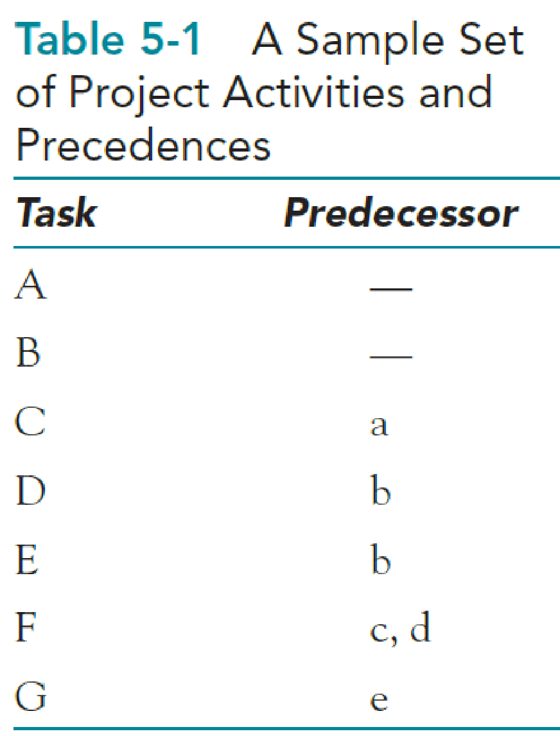
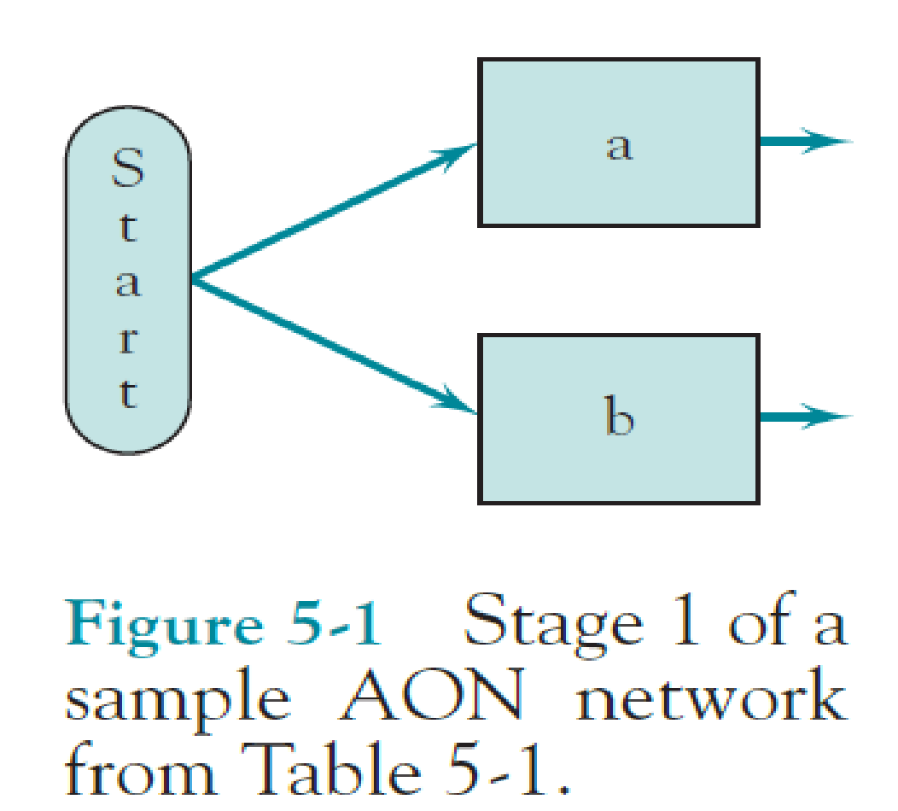

Slide 28
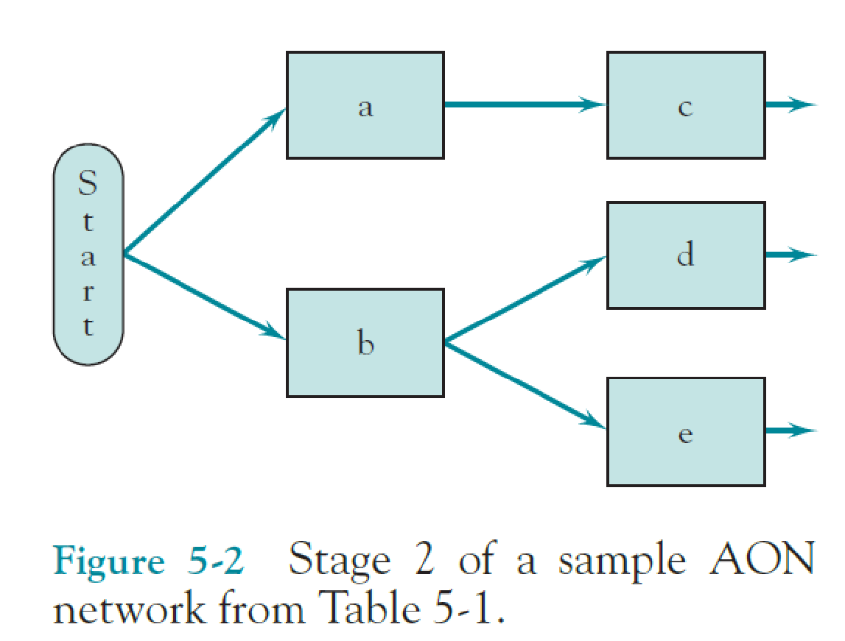
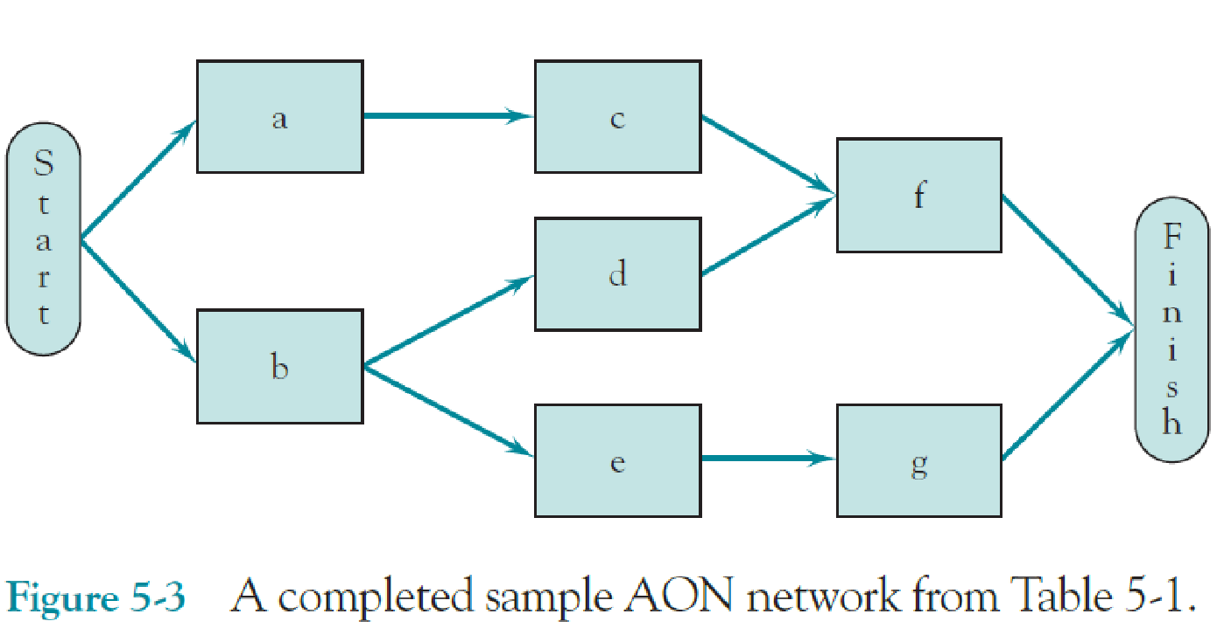

Slide 29
Finding Critical Path

Slide 30
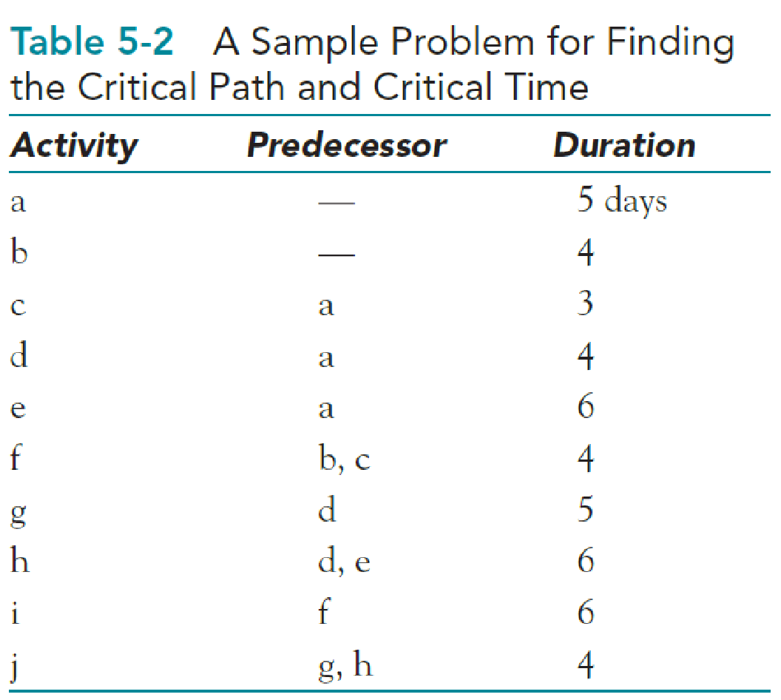

Slide 31
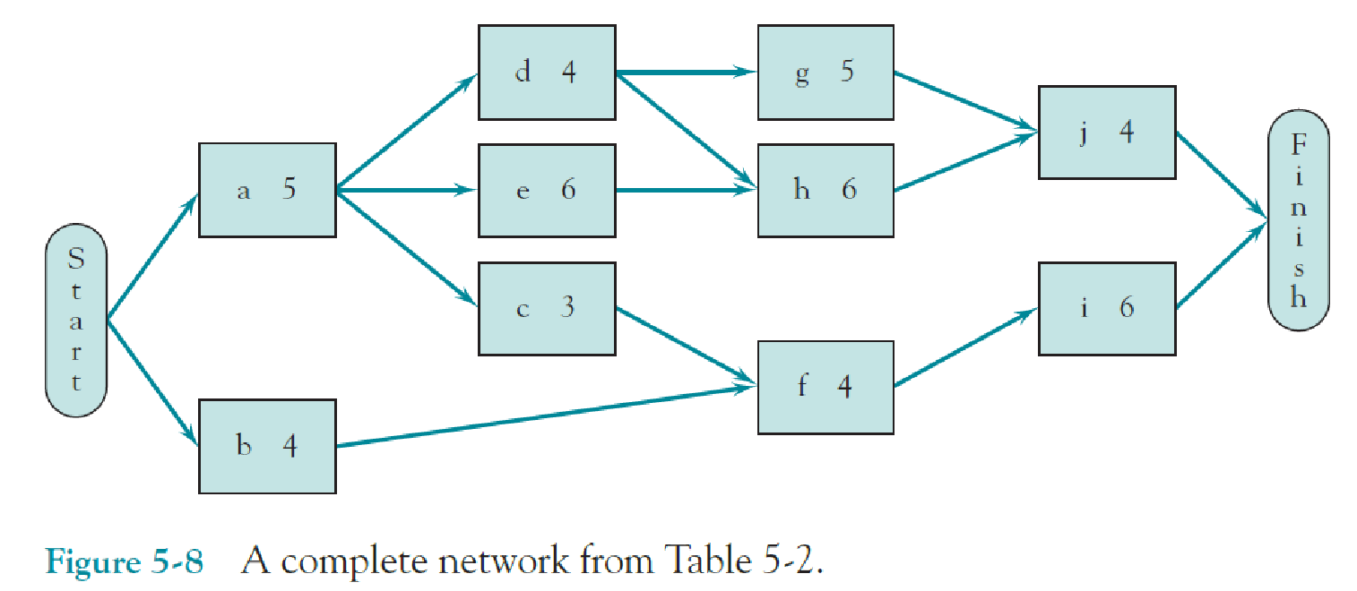
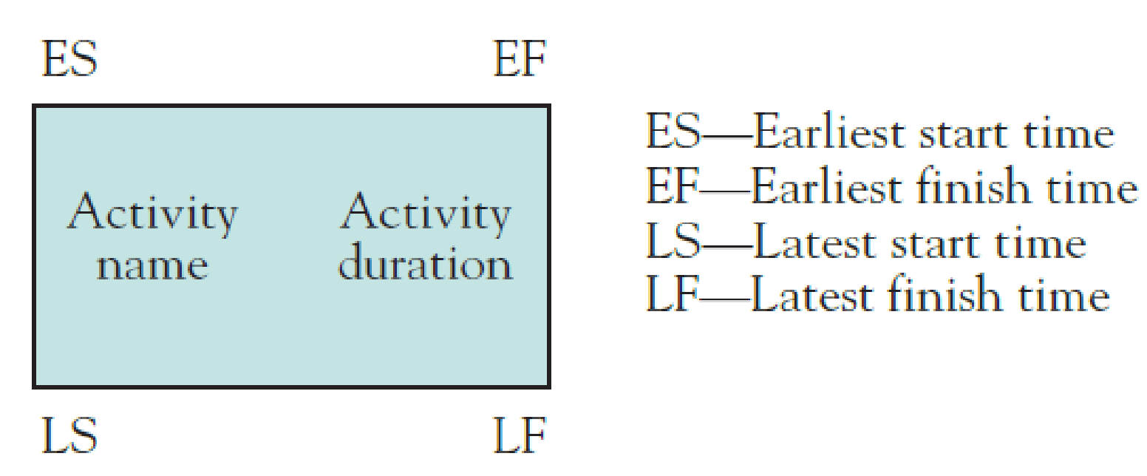

Slide 32
Forward and Backward pass
The ES and EF for each activity are calculated quite easily by beginning at the start node and moving from left to right through the network, calculating as we go from node to node. This is called a “forward pass ” (or “ left - to - right pass ” ) (Max value)
Makes it simple to find the critical path and time for PERT/CPM networks.
We can perform a “backward pass” (or “ right - to - left pass ” ) to calculate the LS and LF values for each activity. (Min value for this pass)
We begin by assuming that we would like to complete the project within the critical time identified in the forward pass, 21 days.
Clearly, activities i and j must be completed no later than Day 21 in order not to delay the entire project. Therefore, these activities both have LFs of 21.

Slide 33
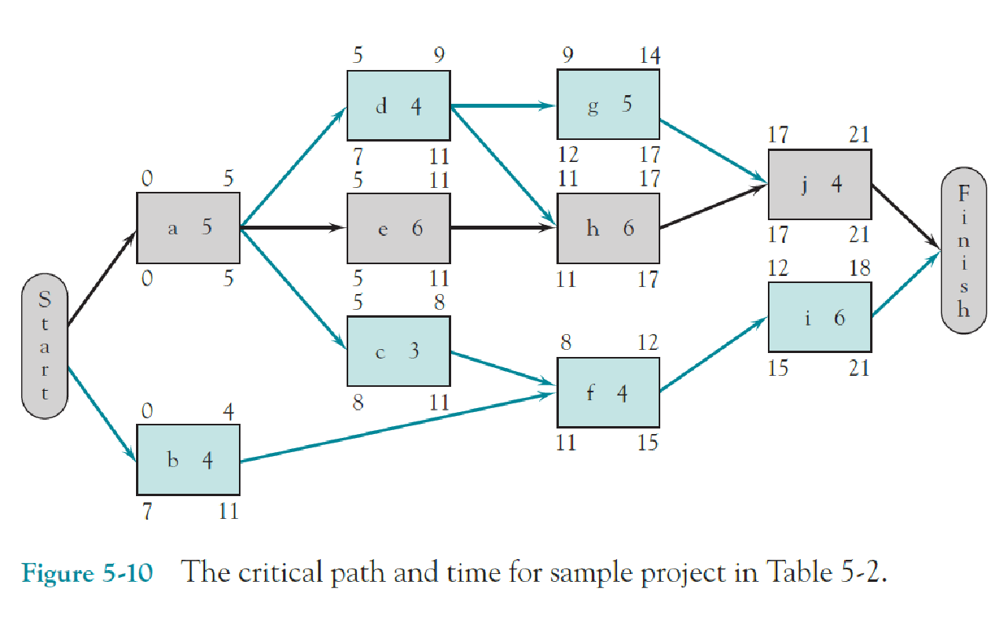

Slide 34
Calculating Slack/Float
Activities on the critical path cannot be delayed without causing the entire project to be delayed
Activities not on the critical path can be delayed without delaying the project? As a matter of fact, it does — within limits.

Slide 35
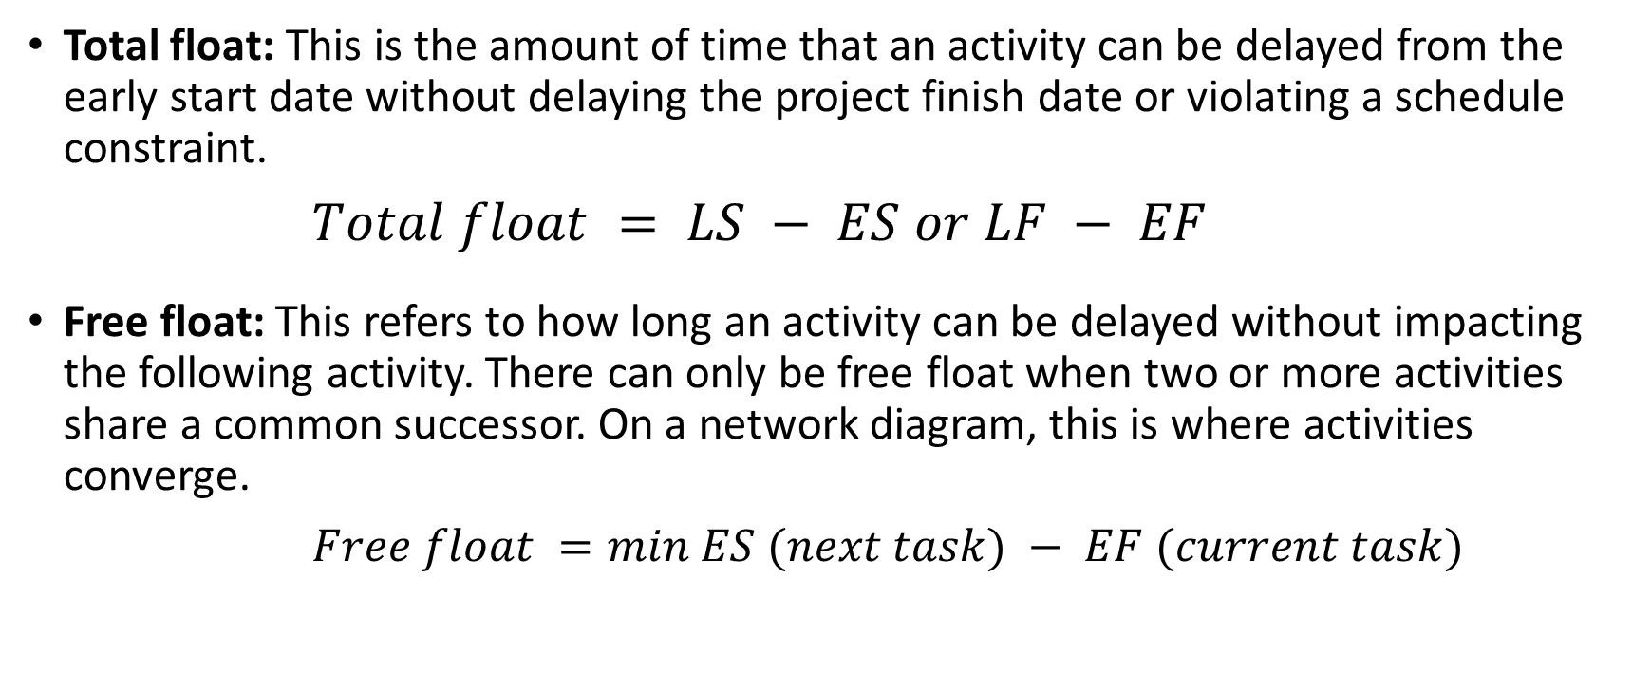
Total float vs. free float

Slide 36
Slack/Total Float
Task | float
a
b
c
d
e
Task | float
f
g
h
i
j
Free Float
Task | float
a
b
c
d
e
Task | float
f
g
h
i
j

Slide 37
Example
Widgetco is about to introduce a new product (product 3).
One unit of product 3 is produced by assembling 1 unit of product 1 and 1 unit of product 2.
Before production begins on either product 1 or 2, raw materials must be purchased and workers must be trained.
Before products 1 and 2 can be assembled into product 3, the finished product 2 must be inspected.
A list of activities and their predecessors and of the duration of each activity is given in Table 12. Draw a project diagram for this project.

Slide 38
Exercise
Activity | Predecessor | Duration (Days)
A = Train workers | -- | 6
B = Purchase new Material | --- | 9
C = produce product 1 | A, B | 8
D = Produce product 2 | A, B | 7
E = test product 2 | D | 10
F = assemble products 1 and 2 | C, E | 10

